Slide 1
Data Preprocessing Tools

Slide 2
Data Preprocessing
Large datasets
  Structured Tables, Images, Audio files, Videos, etc..
Machines don’t understand free text, image, or video data as it is, they understand 1s and 0s.
Step in which the data gets transformed, or Encoded, to bring it to such a state that now the machine can easily parse it.
In other words, the features of the data can now be easily interpreted by the algorithm.

Slide 3
Steps of Data Preprocessing
Not all the steps are applicable for each problem
  Data Quality Assessment
  Feature Aggregation
  Feature Discretization
  Feature Sampling
  Dimensionality Reduction
  Feature Encoding
  Feature Scaling

Slide 4
Data Quality Assessment
Missing values
Outliers
Inconsistent values
Duplicate values

Slide 5
Feature Aggregation
To take the aggregated values in order to put the data in a better perspective.
Example
  day-to-day transactions of a product to record the daily sales of that product in various store locations over the year.
  Aggregating the transactions to single store-wide monthly or yearly transactions will help us reducing hundreds or potentially thousands of transactions that occur daily at a specific store, thereby reducing the number of data objects.
Why?
  This results in reduction of memory consumption and processing time
  Aggregations provide us with a high-level view of the data as the behaviour of groups or aggregates is more stable than individual data objects

Slide 6
Feature Discretization
transforms the data into sets of small intervals
For example, putting people in categories “young”, “middle age”, “senior” rather than working with continuous age values.
Discretization helps to improve efficiency.

Slide 7
Feature Sampling
Sampling is a very common method for selecting a subset of the dataset that we are analyzing.
In most cases, working with the complete dataset can turn out to be too expensive considering the memory and time constraints.
The key principle here is
  the sampling should be done in such a manner that the sample generated should have approximately the same properties as the original dataset, meaning that the sample is representative.
Simple Random Sampling
  Sampling without Replacement
  Sampling with Replacement

Slide 8
Feature Sampling
Simple Random Sampling
  imbalanced dataset
    number of instances of a class(es) are significantly higher than another class(es),
Stratified Sampling
  which begins with predefined groups of objects

Slide 9
Dimensionality Reduction
Most real world datasets have a large number of features.
For example, consider an image processing problem, we might have to deal with thousands of features, also called as dimensions.
Dimensionality reduction aims to reduce the number of features
  but not simply by selecting a sample of features from the feature-set: Feature Subset Selection or simply Feature Selection.
Conceptually, dimension refers to the number of geometric planes the dataset lies in
  More the number of such planes, more is the complexity of the dataset.

Slide 10
Dimensionality Reduction
Dimension reduction maps the dataset to a lower-dimensional space
The basic objective of techniques is to reduce the dimensionality of a dataset by creating new features which are a combination of the old features.
Two widely accepted techniques
  Principal Component Analysis
  Singular Value Decomposition

Slide 11
Feature Encoding
Performing transformations on the data such that it can be easily accepted as input for machine learning algorithms while still retaining its original meaning.
There are some general norms or rules which are followed when performing feature encoding.

Slide 12
General norms or rules which are followed when performing feature encoding
Nominal
  Any one-to-one mapping can be done which retains the meaning.
  For instance, a permutation of values like in One-Hot Encoding.
Ordinal
  An order-preserving change of values.
  Unhappy, Happy, Very Happy- 1,2,3
Interval
  new_value = a*old_value + b, a and b being constants.
  For example, Fahrenheit and Celsius scales, which differ in their Zero values size of a unit
Ratio
  These variables can be scaled to any particular measures, while maintaining the meaning and ratio of their values.
  new_value = a*old_value
  length can be measured in meters or feet, money can be taken in different currencies.

Slide 13
One Hot Encoding
Dummy vars trap

Slide 14
One Hot Encoding Dummy Vars
productivity | Years of Experience | No of years of education | Last Degree
Pr1 | Ex1 | Ed1 | M.Sc
Pr2 | Ex2 | Ed2 | M.Tech
Pr3 | Ex3 | Ed3 | M.Tech
Y= b₀ + b₁*x₁ + b₂*x₂ + b₃*D₁ (for M.Sc.)

Slide 15
Dummy Vars
productivity | Years of Experience | No of years of education | Last Degree | M.Sc. | M.Tech
Pr1 | Ex1 | Ed1 | M.Sc | 1 | 0
Pr2 | Ex2 | Ed2 | M.Tech | 0 | 1
Pr3 | Ex3 | Ed3 | M.Tech | 0 | 1
Y= b₀ + b₁*x₁ + b₂*x₂ + b₃*D₁ (for M.Sc.)

Slide 16
Dummy Var Trap
If we will take var for each dummy vars like
  Y= b₀ + b₁*x₁ + b₂*x₂ + b₃*D₁ (for M.Sc.) +b₄*D₂(for M.Tech.)
  We will duplicate the vars because D₂=D₁-1
  Model will not distinguish the effect of D1 from the effect of D2.
  This is called the dummy var trap
  We can not have constant and all dummy vars at the same time.
  Whenever you build the model, always omit one dummy var.

Slide 17
Feature scaling
Some machine learning algorithms are sensitive to feature scaling while others are virtually invariant to it.
We need to perform Feature Scaling when we are dealing with
  Gradient Descent Based algorithms and
    Linear and Logistic Regression, Neural Network
  Distance-based algorithms
    KNN, K-means, SVM
  As these algorithms are very sensitive to the range of the data points.

Slide 18
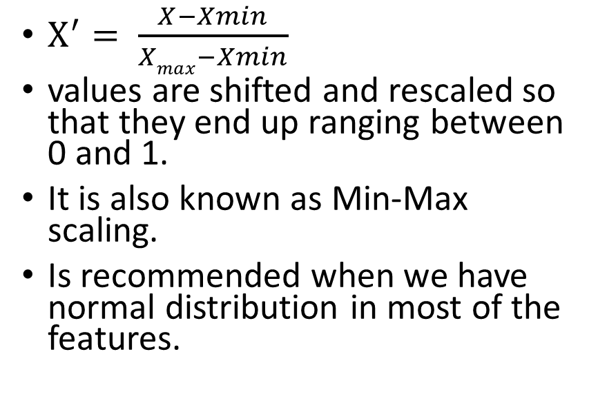
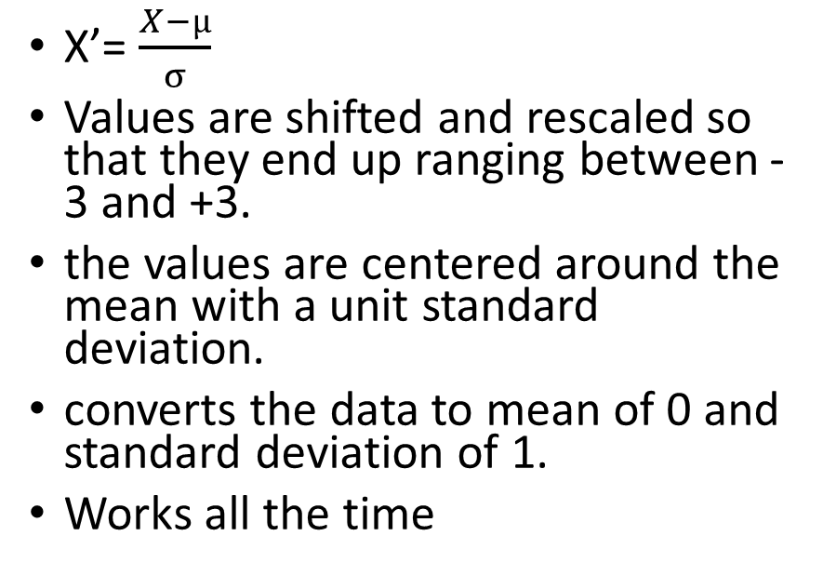
Feature Scaling
Standardization
Normalization
X’= $\frac{X−µ}{σ}$
Values are shifted and rescaled so that they end up ranging between -3 and +3.
the values are centered around the mean with a unit standard deviation.
converts the data to mean of 0 and standard deviation of 1.
Works all the time
$X^{′}= \frac{X−Xmin}{Xmax−Xmin}$
values are shifted and rescaled so that they end up ranging between 0 and 1.
It is also known as Min-Max scaling.
Is recommended when we have normal distribution in most of the features.

Slide 19
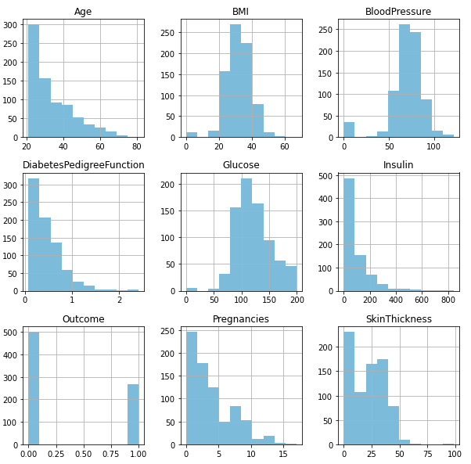
Gaussian Distribution — BMI, BloodPressure, Glucose.
Non-Gaussian Distribution — Age, DiabetesPedigreeFunction, Insulin, Pregnancies, SkinThickness
Normalize Non-Gaussian features and Standardize Gaussian-like features

Slide 20
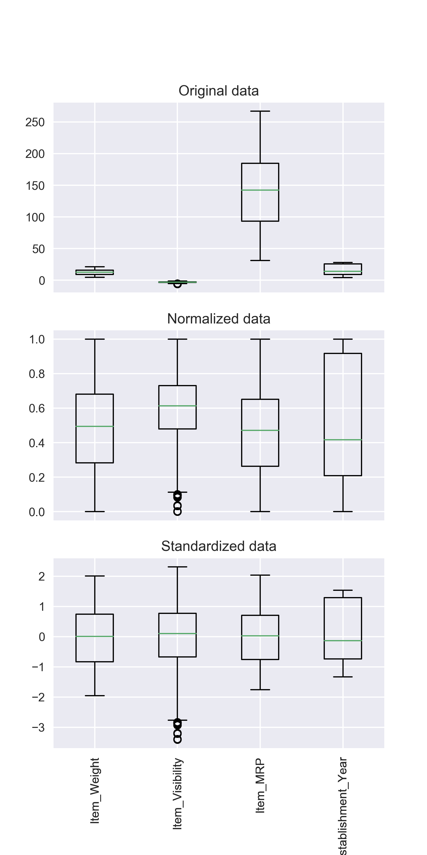
features are now more comparable and will have a similar effect on the learning models

Slide 21
Feature Scaling Requirement
Gradient Descent Based Algorithms
  linear regression, logistic regression, neural network, etc. that use gradient descent as an optimization technique require data to be scaled
  Having features on a similar scale can help the gradient descent converge more quickly towards the minima
Distance-Based Algorithms
  KNN, K-means and SVM
  are most affected by the range of features.
  they are using distances between data points to determine their similarity.
  there is a chance that higher weightage is given to features with higher magnitude.
Tree-Based Algorithms
  are fairly insensitive to the scale of the features.

Slide 22
Framework
Importing the libraries
Importing the dataset
Taking care of missing data
Encoding categorical data
  Encoding the Independent Variable
  Encoding the Dependent Variable
Splitting the dataset into the Training set and Test set
Feature Scaling

Slide 23
Importing the libraries
import numpy as np
import matplotlib.pyplot as plt
import pandas as pd

Slide 24
Importing the dataset
dataset = pd.read_csv('Data.csv')
X = dataset.iloc[:, :-1].values
y = dataset.iloc[:, -1].values
print(X)
  [['France' 44.0 72000.0] ['Spain' 27.0 48000.0] ['Germany' 30.0 54000.0] ['Spain' 38.0 61000.0] ['Germany' 40.0 nan] ['France' 35.0 58000.0] ['Spain' nan 52000.0] ['France' 48.0 79000.0] ['Germany' 50.0 83000.0] ['France' 37.0 67000.0]]
print(y)
  ['No' 'Yes' 'No' 'No' 'Yes' 'Yes' 'No' 'Yes' 'No' 'Yes']

Slide 25
Dataset (data.csv)
Country | Age | Salary | Purchased
France | 44 | 72000 | No
Spain | 27 | 48000 | Yes
Germany | 30 | 54000 | No
Spain | 38 | 61000 | No
Germany | 40 |  | Yes
France | 35 | 58000 | Yes
Spain |  | 52000 | No
France | 48 | 79000 | Yes
Germany | 50 | 83000 | No
France | 37 | 67000 | Yes

Slide 26
Taking care of missing data
from sklearn.impute import SimpleImputer
imputer = SimpleImputer(missing_values=np.nan, strategy='mean')
imputer.fit(X[:, 1:3])
X[:, 1:3] = imputer.transform(X[:, 1:3])
print(X)
  [['France' 44.0 72000.0] ['Spain' 27.0 48000.0] ['Germany' 30.0 54000.0] ['Spain' 38.0 61000.0] ['Germany' 40.0 63777.77777777778] ['France' 35.0 58000.0] ['Spain' 38.77777777777778 52000.0] ['France' 48.0 79000.0] ['Germany' 50.0 83000.0] ['France' 37.0 67000.0]]

Slide 27
Encoding categorical data:
Encoding the Independent Variable
from sklearn.compose import ColumnTransformer
from sklearn.preprocessing import OneHotEncoder
ct = ColumnTransformer(transformers=[('encoder', OneHotEncoder(), [0])], remainder='passthrough')
X = np.array(ct.fit_transform(X))
print(X)
  [[1.0 0.0 0.0 44.0 72000.0] [0.0 0.0 1.0 27.0 48000.0] [0.0 1.0 0.0 30.0 54000.0] [0.0 0.0 1.0 38.0 61000.0] [0.0 1.0 0.0 40.0 63777.77777777778] [1.0 0.0 0.0 35.0 58000.0] [0.0 0.0 1.0 38.77777777777778 52000.0] [1.0 0.0 0.0 48.0 79000.0] [0.0 1.0 0.0 50.0 83000.0] [1.0 0.0 0.0 37.0 67000.0]]

Slide 28
Encoding categorical data:
Encoding the Dependent Variable
from sklearn.preprocessing import LabelEncoder
le = LabelEncoder()
y = le.fit_transform(y)
print(y)
  [0 1 0 0 1 1 0 1 0 1]

Slide 29
Splitting the dataset into the Training set and Test set
from sklearn.model_selection import train_test_split
X_train, X_test, y_train, y_test = train_test_split(X, y, test_size = 0.2, random_state = 1)
print(X_train)
  [[0.0 0.0 1.0 38.77777777777778 52000.0] [0.0 1.0 0.0 40.0 63777.77777777778] [1.0 0.0 0.0 44.0 72000.0] [0.0 0.0 1.0 38.0 61000.0] [0.0 0.0 1.0 27.0 48000.0] [1.0 0.0 0.0 48.0 79000.0] [0.0 1.0 0.0 50.0 83000.0] [1.0 0.0 0.0 35.0 58000.0]]
print(X_test)
  [[0.0 1.0 0.0 30.0 54000.0] [1.0 0.0 0.0 37.0 67000.0]]

Slide 30
Splitting the dataset into the Training set and Test set
print(y_train)
  [0 1 0 0 1 1 0 1]
print(y_test)
  [0 1]

Slide 31
Feature Scaling
from sklearn.preprocessing import StandardScaler
sc = StandardScaler()
X_train[:, 3:] = sc.fit_transform(X_train[:, 3:])
X_test[:, 3:] = sc.transform(X_test[:, 3:])
Note: for test set we will use same scaling so we will call only transform method in place of fit_transform
print(X_train)
  [[0.0 0.0 1.0 -0.19159184384578545 -1.0781259408412425] [0.0 1.0 0.0 -0.014117293757057777 -0.07013167641635372] [1.0 0.0 0.0 0.566708506533324 0.633562432710455] [0.0 0.0 1.0 -0.30453019390224867 -0.30786617274297867] [0.0 0.0 1.0 -1.9018011447007988 -1.420463615551582] [1.0 0.0 0.0 1.1475343068237058 1.232653363453549] [0.0 1.0 0.0 1.4379472069688968 1.5749910381638885] [1.0 0.0 0.0 -0.7401495441200351 -0.5646194287757332]]
print(X_test)
  [[0.0 1.0 0.0 -1.4661817944830124 -0.9069571034860727] [1.0 0.0 0.0 -0.44973664397484414 0.2056403393225306]]

